Slide 1
Navigating the Future: The Role of Collaborative Robots (Cobots) in Industry 5.0
Presented by:
Maryam Amir (502540)
Sara Shahzad (530654)

Slide 2
Objectives
01
02
Cobots and their function
Opportunities Cobot’s present
03
04
Applications of Cobots
Challenges associated with the implementation of Cobots
05
Ethical Considerations

Slide 3
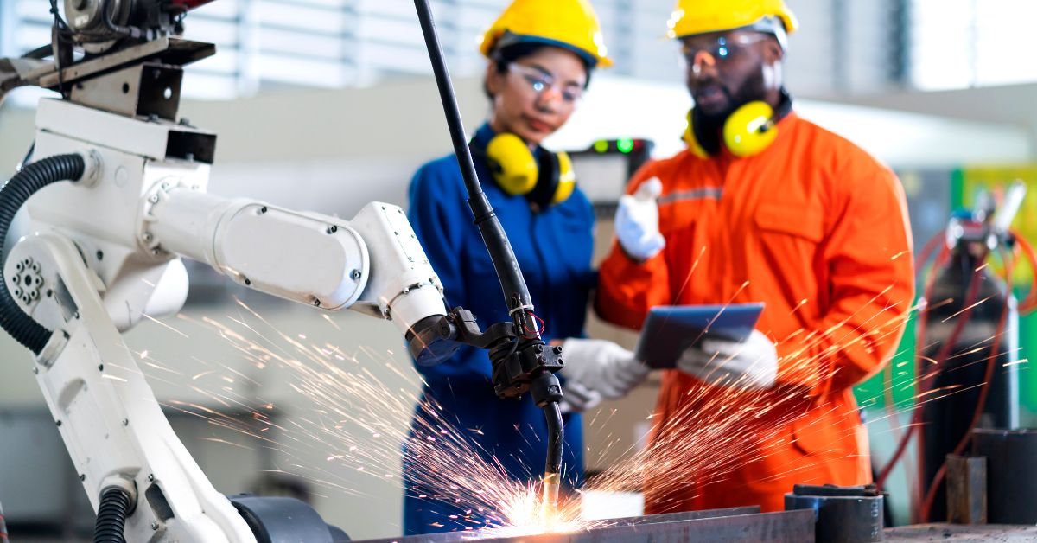
Methodology
While researching the role of collaborative robots in industry the following resources were used:
Research Papers available on Google Scholar
Articles from websites like WiredWorkers, Wevolver
IEEE Journals and Magazines

Slide 4
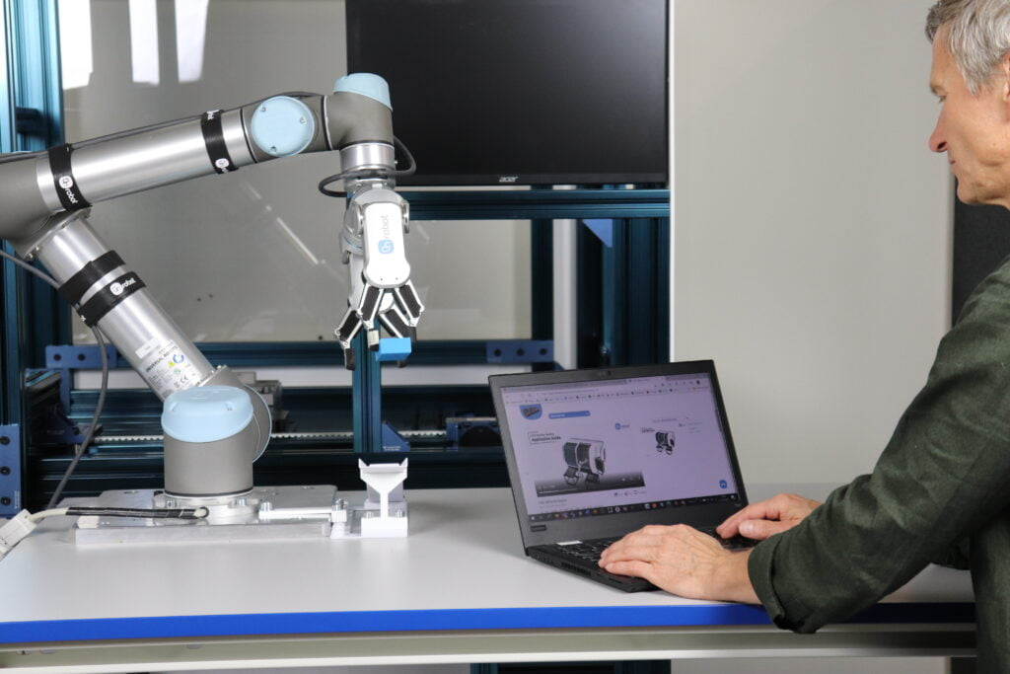
01
What are Cobots and how do they function
Cobots or collaborative robots are designed to work with humans in a shared workplace

Slide 5
Cobots Vs Traditional Robots
Features | Cobots | Traditional Robots
Design | Precise Light weight Humans can work with them without any safety barriers | Heavy Fixed position Require external safety features – humans need safety barriers to work with them
Adaptibility | Work on multiple tasks or operations | Work on a specific task only
Cost Effective | Low maintenance costs Lower energy consumption Average ROI of one year | Hight initial investment and maintenance costs
Integration in Different Workplaces | Repurposed for different tasks | Can’t be used where products are frequently changing
Notes:
ROI return of investment

Slide 6
Design Principles
01
Safety
02
03
Flexibility in Operations
Easy to Use

Slide 7
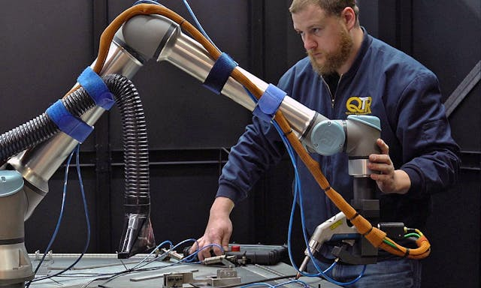
Design Principles
01
Safety
02
Flexibility in Operations
03
Easy to Use
Built in safety mechanism like force limiting
Response of less than 1 ms
Use advanced sensors and cameras to evaluate their surroundings
Lightweight and made of soft materials so can absorb impact

Slide 8
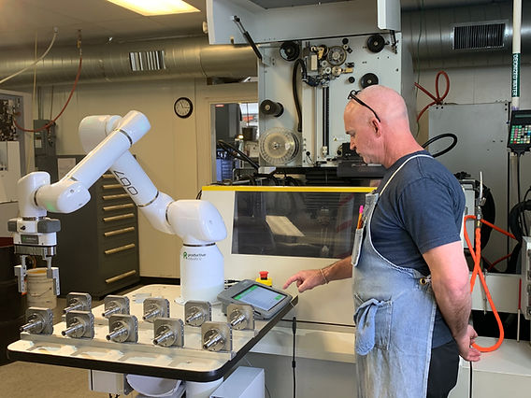
Design Principles
01
02
Safety
Flexibility in Operations
03
Easy to Use
Performs repetitive tasks like packaging, assembly line, quality checks etc
With the help Machine Learning, they can adapt to any workflow

Slide 9
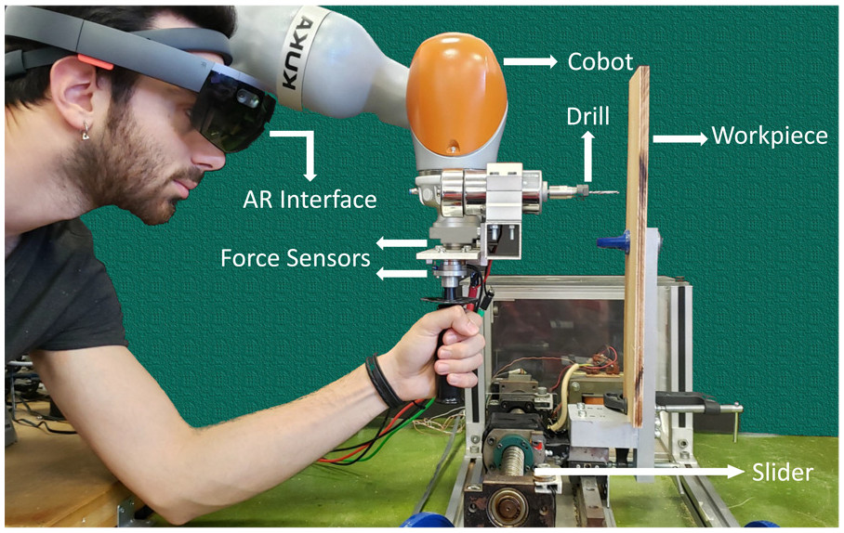
Design Principles
01
03
Safety
Easy to Use
02
Flexibility in Operations
Operate it without any technical knowledge
Interactive interface makes it easy to repurpose for new activities

Slide 10
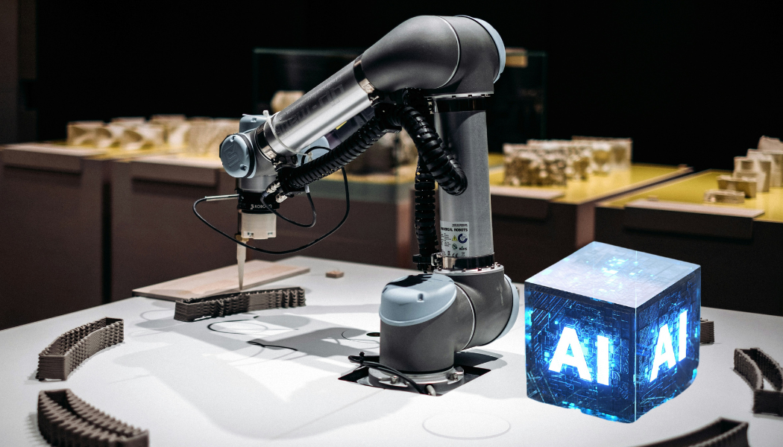
How Machine Learning (ML) Algoritms improve Cobots function and decsion making ability?

Slide 11
Naïve Bayes
Decision Tree
K Means Clustering
Deep learning
Supervised learning -> Classification
Classifies data based on leaftures from labelled data set
Assumes that features arent interdependent – so can’t be used in Cobot’s learning
Supervised Learnig -> Classification
Leads to overfitting (works poorly on unseen data) so affects the overall performance of the Cobot.
Facilitates Cobot to learn on its own – making them adaptable to any environment
DL uses neural networks (similar to human's neuron system) to derive output
Between input and output layer there are several hidden layer aka nodes – these nodes are given weight and adjusted using backpropagation to minimize errors in decision making ability
Unsupervised Learning -> Clustering
Model finds hidden patterns in data – creates decision boundaries
Can be used as works well with noisy and multi dimensional data, commonly found in Cobot’s systems

Slide 12
How these Models assist Cobots?
Learn optimal paths and angles for movement, or the nest sequence of operations to minimize time and energy consumption
Differentiate between different situations and adapt their techniques, strength, and precision accordingly
Predictive Maintenance
Real-Time Learning
Task Optimization
Predict maintenance times – increases life span of Cobot

Slide 13

02
What opportunities Cobot’s present

Slide 14
Addressing Rising Costs and Labour Shortages
Cost Efficiency: Cheaper than hiring human labour. Work continously without breaks – leading to higher output and efficiency
Scalability: Scale operations by using more Cobots – flexible response to market demand without the lengthy process of hiring human labour.

Slide 15
Compact Design and Easy Integration
Space Optmization: Can be used in tight spaces. Don’t takeup much space so manufactures can use floor space more effectively
Flexible Workflow: Can easily be repurposed for different tasks, giving manufactures flexibilty to adjust workflows as needed

Slide 16
Improvements in Workplace Safety
Hazardous Task Handling: Can work in extreme conditions eg handling heavy metals, toxic substances etc – reducing risk of accidents

Slide 17
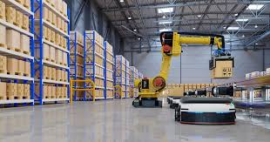
03
What are applications of Cobots in Manufacturing Industry

Slide 18
Applications
Detects defects or inconsistencues in products with the help of its sensors and camersa
Enusres high quality product
Assist in inventory managemnt, sortinga and order fulfillment
Assembly Tasks
Quality Control
Precision Tasks
Logistics and Warehousing
Perform repititive tasks like fastening screws, component placement
Reuduecs physical strain on human workers
Perform tasks like sanding, drilling etc
Maintains quality and accuracy

Slide 19
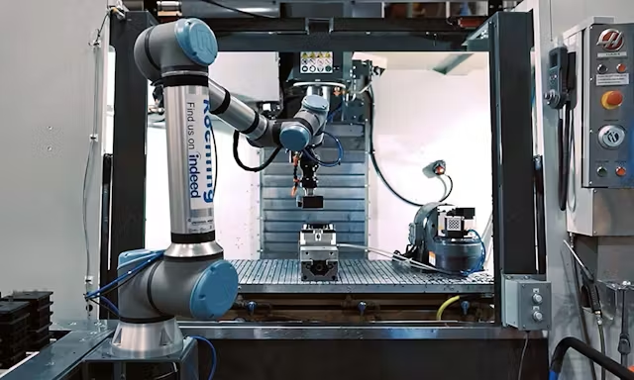
04
Challenges associated with implementation of Cobots

Slide 20
Recognize challenges in integrating cobots, especially into existing systems.
Integrating cobots requires costly infrastructure adjustments and reengineering of rigid automation systems.
The transition period can disrupt workflow and reduce productivity if not managed properly.
Complex programming is needed for safe, real-time communication between cobots, machinery, and humans.

Slide 21
Evaluate economic factors, emphasizing the costs of initial investment and personnel training to work alongside cobots.
The economic challenges of implementing cobots include high initial costs for cobots, installation, training, and programming.
Small to medium-sized enterprises (SMEs) face difficulties due to the substantial expenses, including maintenance and electricity.
Employee training for new skills, such as programming and troubleshooting, increases costs and may reduce productivity during the transition.

Slide 22
Discuss workforce concerns, which include job displacement and growing requirements for advanced skillsets.
Cobots take over repetitive tasks, but workers fear job displacement.
Workers feel unprepared to collaborate with cobots due to a lack of advanced skills.
A skills gap exists, requiring training programs to prepare the workforce for future technology.

Slide 23
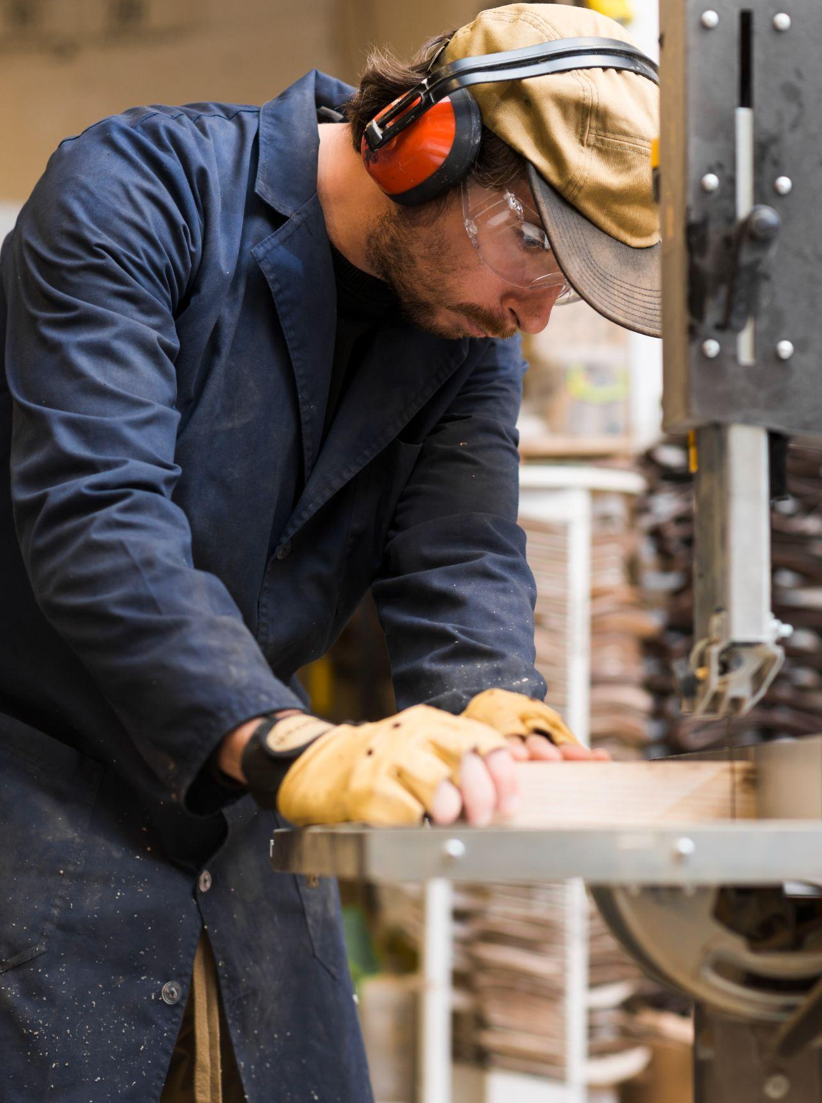
05
What ethical considerations must be taken into account?

Slide 24
Considering data breaching concerns, mainly due to the integration of AI in cobots.
Cobots are vulnerable to cyberattacks due to reliance on real-time data from sensors and cameras.
Increased connectivity via cloud and IoT raises privacy concerns and exposes cobots to hacking risks.
Strong cybersecurity and GDPR compliance are essential to protect data and ensure safe operation.

Slide 25
Discuss the balance between technological advancement and societal impacts, including strategies for workforce transitions.
Cobots improve productivity but may cause job displacement in manual labor sectors.
Ethical strategies, like training workers for new roles, are needed to support workforce transitions.
Clear communication is essential to prevent resentment and ensure successful cobot integration.

Slide 26

Ensure ethical implementations by use of industry regulations and standards.
Regulations like ISO 10218 ensure ethical cobot implementation, addressing safety and privacy concerns.
Global standards from organizations like ISO and IEEE help minimize negative social and economic impacts.

Slide 27
References
Human factors in cobot era: a review of modern production systems features | Journal of Intelligent Manufacturing
Cobots: What are They and Why Are They Becoming Important? | AI Magazine
What is a Cobot? Advanced Guide to Collaborative Robot Architecture and Implementation
A Review on the Effectiveness of Machine Learning and Deep Learning Algorithms for Collaborative Robot | Archives of Computational Methods in Engineering
Cobot programming for collaborative industrial tasks: An overview - ScienceDirect
Intelligent Robots and Cobots - Intelligent Robots and Cobots - Wiley Online Library
Full article: Application, Development and Future Opportunities of Collaborative Robots (Cobots) in Manufacturing: A Literature Review

Slide 28

Thanks!

